Slide 1
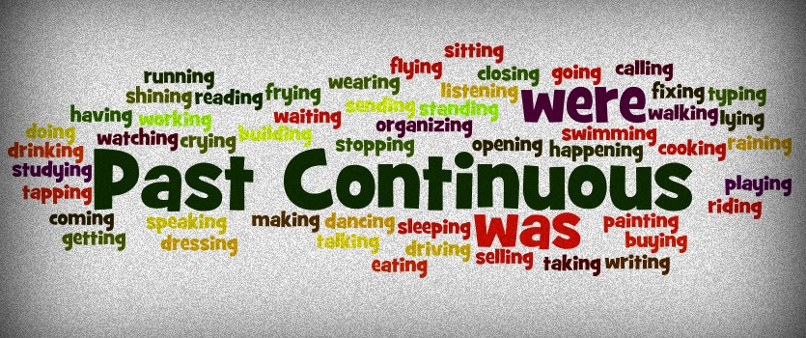

Slide 2

USE 1 Continuous Action in the Past interrupted by a specific time.
We use the Past Continuous Tense to talk about an action that was taking place at a particular time in the past:
She was riding her bike yesterday at 2 p.m.
They were playing table tennis at 10 last night.
I was listening to music yesterday morning.

Slide 3
USE 2: Continuous Action in the Past interrupted by Past Action.
We can also use the Past Continuous and the Simple Past in the same sentence. We do this when we want to express that a shorter activity took place during a longer activity in the past:
Lara hurt herself when she was jumping over the vaulting horse.
Notice the position of “when” and the use of the comma (,):
When I arrived home, they were watching TV.
She was peeling an apple when she cut herself.
Short Action
Long Action

Slide 4
Notice the difference in meaning between these two sentences:
When the students came to the class, the teacher was leaving.
When the students came to the class, the teacher left.
In the first sentence, the teacher started to leave when the students arrived, the action of leaving was in progress when the other action happened (One sentence is in the Past Continuous and the other in the Simple Past).
In the second sentence, the students arrived and then the teacher left, one action happened after the other (Both sentences are in the Simple Past).

Slide 5
USE 3: Parallel Actions.
When you use the Past Continuous with two actions in the same sentence, it expresses the idea that both actions were happening at the same time. The actions are parallel.
I was cooking and my sister was cleaning the house.
We were watching TV while they were talking very loudly.
While Ellen was reading, Tim was watching television.

Slide 6
USE 4: Creating Atmosphere.
In English, we often use a series of parallel actions to describe and create the atmosphere at a particular time in the past:
When I walked into the office, several people were busily typing, some were talking on the phones, the boss was yelling directions, and customers were waiting to be helped. One customer was yelling at a secretary and waving his hands. Others were complaining to each other about the bad service.

Slide 7
USE 5: Repetition and Irritation with "Always“.
The Past Continuous with words such as "always" or "constantly" expresses the idea that something irritating or shocking often happened in the past. The concept is very similar to the expression “used to" but with negative emotion. Remember to put the words "always" or "constantly" between "be" and "verb+ing.“
She was always coming to class late.
He was constantly talking. He annoyed everyone.
I didn't like them because they were always complaining.

Slide 8

PAST CONTINUOUS
[was/were + present participle]
Positive | Negative | Question
I was singing. You were singing. We were singing. They were singing. He was singing. She was singing. It was singing. | I was not singing. You were not singing. We were not singing. They were not singing. He was not singing. She was not singing. It was not singing. | Was I singing? Were you singing? Were we singing? Were they singing? Was he singing? Was she singing? Was it singing?

Slide 9
IMPORTANT
In the Simple Past, a specific time is used to show when an action began or finished. In the Past Continuous, a specific time only interrupts the action.
Examples:
Last night at 6 PM, I ate dinner. (I started eating at 6 PM.)
Last night at 6 PM, I was eating dinner. (I started earlier; and at 6 PM, I was in the process of eating dinner.)

Slide 10
While vs. When
Clauses are groups of words which have meaning, but are often not complete sentences. Some clauses begin with the word "when" such as "when she called" or "when it bit me." Other clauses begin with "while" such as "while she was sleeping" and "while he was surfing." When you talk about things in the past, "when" is most often followed by the verb tense Simple Past, whereas "while" is usually followed by Past Continuous. "While" expresses the idea of "during that time.“
I was studying when she called.
While I was studying, she called.

Slide 11
Read the text and complete with the correct verb tense.
Last night, while I was doing my homework, Angela _________(call) . She said she _________ (call) me on her cell phone from her biology classroom at UCLA. I asked her if she _________ (wait) for class, but she said that the professor was at the front of the hall lecturing while she _________ (talk) to me. I couldn't believe she _________ (make) a phone call during the lecture. I asked what was going on.
She said her biology professor was so boring that several of the students _________ (sleep, actually) in class. Some of the students _________(talk) about their plans for the weekend and the student next to her _________ (draw) a picture of a horse.

Slide 12
Past Simple – Past Continuous
Try to make a sentence including the following pair of words using the Past Simple and Past Continuous tenses. For example:
alligator - wallpaper
“When I was covering my son’s bedroom with teddy bear wallpaper, he suddenly came in and said he wanted alligator patterns instead”.
evidence – police officer
dwarf – neighbor
music – parents
English – swimming pool
plane – trainers

Slide 13
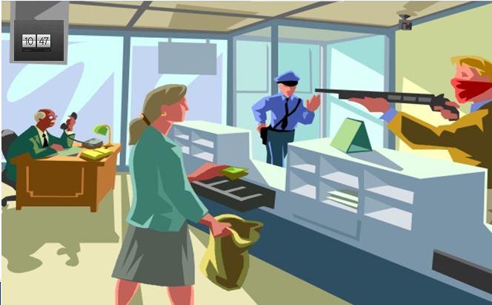
Picture Memory
Take a look at the picture for 1 minute…

Slide 14
Now try to remember and answer the questions below…
How many people were there?
Where were the people?
What was hanging from the ceiling?
What was the bank robber holding?
What was the bank robber wearing?
What color was his hair?
What was covering the bank robber’s face?
Was the bank robber right-handed or left-handed?
What was the bank manager doing?
What was the bank teller doing?
Who was walking into the bank?
What time was it?
Was the bank teller wearing a pair of trousers?

Slide 15

PAST SIMPLE TENSE review

Slide 16
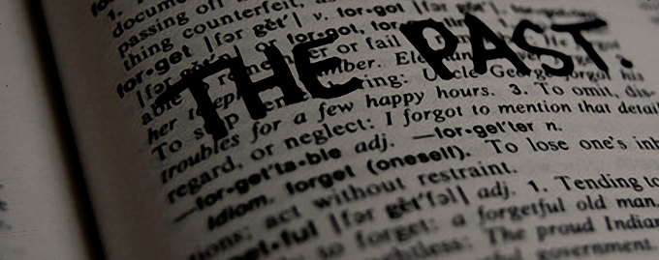
The simple past tense refers to:
an action which occurred at a specific time in the past: I ate a salad for lunch today.
He worked all day yesterday.
a completed action: She finally mailed the letter.
Marie finished her report on time.
past status:
Jane was a movie star.
I was a very good student at high school.

Slide 17
Verb “To Be”
WAS
I was born in Villa María.
She was a doctor in the USA.
He was in Africa last summer.
It was cold yesterday.
I – she – he – it
WERE
We were at home last night.
They were my friends when I was a child.
You were right!
You – they – we

Slide 18
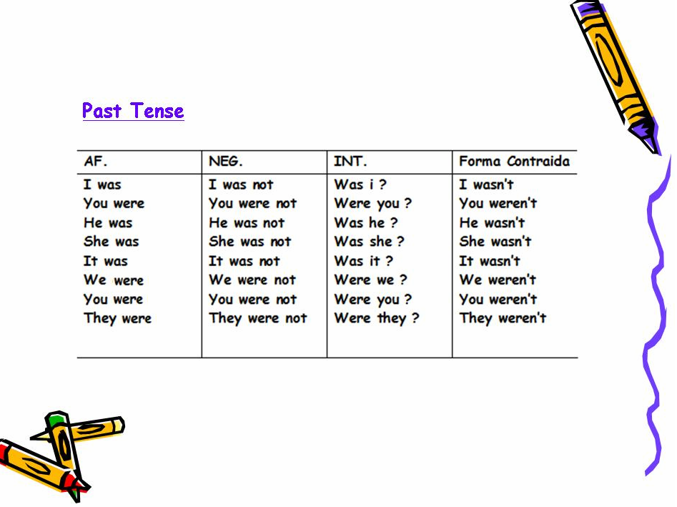

Slide 19
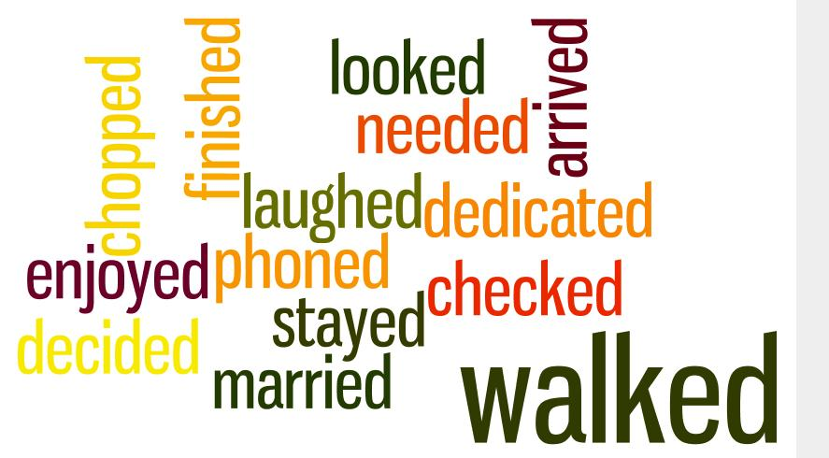
Past Simple: regular verbs
Most verbs in English have a regular form in their past, that is, they only add “-ed” or “-d” to the base form of the verb.
I arrived late to the conference yesterday.
My brother lived in Spain for three years.
When she was young, she danced very well.

Slide 20
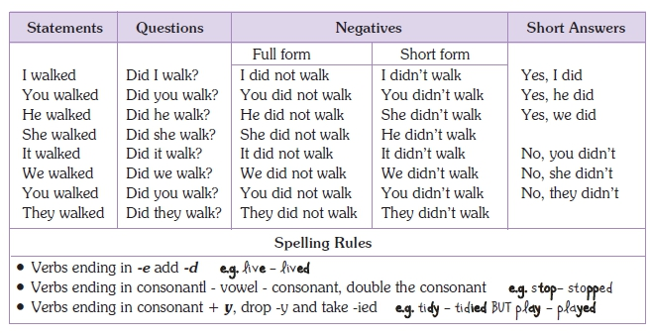

Slide 21
Spelling rules
If a regular verb ends in consonant + y change y to i and add –ed: carry - carried, study - studied, fry - fried, try - tried.
If a one syllable regular verb ends in consonant + vowel + consonant double the final consonant and add -ed: stop - stopped, plan - planned, beg - begged.
If a regular verb has more than one syllable and ends in consonant + vowel + consonant, we double the final consonant only if the final syllable is stressed: preFER - preferred, regRET - regretted.
Exception: In British English verbs ending in -l have -ll before -ed whether the final syllable is stressed or not: travel - travelled.

Slide 22
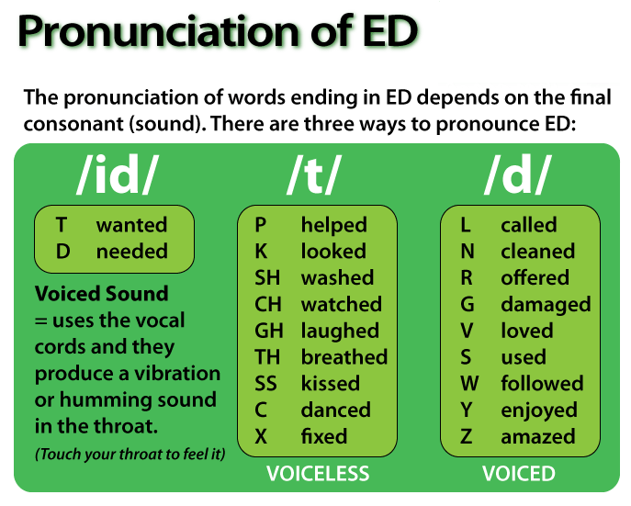

Slide 23

Past Simple: irregular verbs
There are also some verbs called irregular verbs that have special past tense forms:
We went (go) to University yesterday.
The children read (read) that story last year.
The students forgot (forget) to do the project.

Slide 24
AFFIRMATIVE | QUESTIONS | NEGATIVES | SHORT ANSWERS
I went | Did I go...? | I did not (didn't) go | Yes, I did
You went | Did you go...? | You did not (didn't) go | Yes, he did
He went | Did he go...? | He did not (didn't) go | Yes, we did
She went | Did she go...? | She did not (didn't) go
It went | Did it go...? | It did not (didn't) go
We went | Did we go...? | We did not (didn't) go | No, you didn't
You went | Did you go...? | You did not (didn't) go | No, she didn't
They went | Did they go...? | They did not (didn't) go | No, they didn't

Slide 25
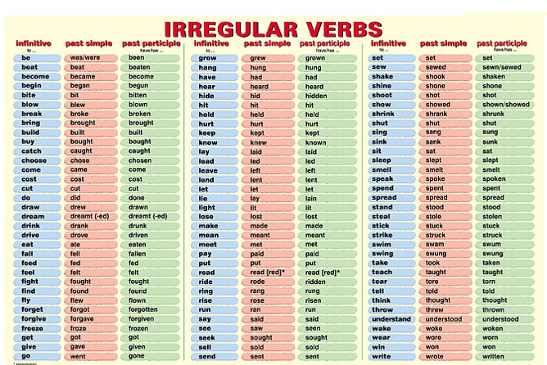

Slide 26


Slide 27
Past Continuous:
http://www.ompersonal.com.ar/INTERMEDIATE/unit13/page1.htm
Past Continuous and Past Simple:
http://www.ompersonal.com.ar/INTERMEDIATE/unit13/page2.htm
http://www.englishpage.com/verbpage/verbs3.htm
http://www.englishpage.com/verbpage/verbs4.htm

